Slide 1
Complexity of Bootstrap
The bootstrap method is a statistical technique for estimating quantities about a population by averaging estimates from multiple small data samples.
In more complex data situations, figuring out the appropriate way to generate bootstrap samples can require some thought.
For example, if the data is a time series, we can’t simply sample the observations with replacement.
Take Stock Market Example – What parts of the data are independent?
Block Bootstrap - We can create blocks of consecutive observations, and sample those with replacement. Then we paste together sampled blocks to obtain a bootstrap dataset.
Could sample with replacement given a block instead of the entire population.
Need to find parts of the data that are uncorrelated and use that as a basis of the bootstrap.

Slide 2
Bootstrap Uses
Primary usage is to calculate the standard error of an estimate.
Also provides approximate confidence intervals for a population parameter.
Bootstrap and the estimate of prediction error
In cross-validation, each of the K validation folds is distinct from the other K-1 folds used for training: there is no overlap. This is crucial for success.
To estimate prediction error using bootstrap, we could think about using each bootstrap dataset as our training sample, and the original sample as our validation sample.
But each bootstrap sample has significant overlap which the original data. A majority of the original data points appear in each bootstrap sample. This will cause the bootstrap to seriously underestimate the true prediction error.
If we were to use the original sample = training sample, and the bootstrap dataset = validation sample – this is actually worse.

Slide 3
Removing the Overlap? Useful or Not Useful?
Can partly fix this problem by using predictions for those observations that did not (by chance) occur in the current bootstrap sample.
But, this method gets complicated in the end, and cross-validation provides a simpler, more attractive approach for estimating prediction error.
If you can get the job done with a simpler method, keep it simple!

Slide 4
Train Function out of Caret
The train function can be used to evaluate, using resampling, the effect of model tuning parameters on performance, choose the optimal model across these parameters, estimate model performance from a training set.
As we saw in Chapter 4 in our KNN models, when the method is not set, Bootstrap Resampling is used.
Validation - no trainControl
LOOCV - trainControl <- trainControl(method = "LOOCV")
K-fold - trainControl <- trainControl(method = "cv", number = 10)
Bootstrap - trainControl <- trainControl(method = "boot", number = 100)
Need boot function

Slide 5
Review for Final Exam
3.5 hour window for exam unless documented accommodation is made in advance.
Final Exam 8:30 – Noon on December 13rd

Slide 6
Chapter 1
Intro to Statistical Learning
Understanding the Vs. (Volume, Variety, Velocity, Variability, Veracity, and Value)
Correlation vs. Causation
Issues with Statistical Analysis
The Third Variable Problem
Requiring a large R^2
Multicollinearity
The Directionality Problem
Measurement Error
Selection Bias
Spurious relationship
Case 1 applied on all of these items
Case 1 applied on all of these items

Slide 7
Chapter 2
Reducible error vs. Irreducible error
Supervised Learning vs. Unsupervised Learning
Parametric Models vs. Non-Parametric Models
The trade-off between prediction accuracy and model interpretability
The importance of sample size
Overfitting and underfitting the model
Bias/Variance Tradeoff
Understanding and using variables
Loading data from multiple files
Inspecting data structures and getting to know dataset multiple ways.
Coerce data into the correct data types
Make and interpret base graphics
These concepts were revisited in Chapters 3, 4, and 5

Slide 8
Chapter 3
What is predictive modelling?
Knowing all the different ways to name an X variable and a Y variable and understanding where they fit in the regression equation
Simple Linear Regression
Multiple Linear Regression
Backward selection
Forward selection
Mixed selection
Adding Interaction Terms
Adding Qualitative Predictors
Dummy Variables
Transforming variables in the model
Knowing how to read the output and make the best decisions based on what you find.
Notations in Calculations
RSS/TSS/SSR
R-square
Adjusted R-square
Confidence Intervals
Interpreting slopes and Intercepts
Knowing when to delete predictors and when not to delete predictors
Assumptions of Linear Regression
Linearity
Normality of Errors
Independence of Errors
Homoscedasticity
Absence of Multicollinearity
When more than 1 predictor variable)
Visualize and Interpret Models with small numbers of predictors
Case 2 applied these concepts
Case 3 applied these concepts
Case 3 included these terms

Slide 9
Chapter 4
Classification definition and usefulness
Dependent Variable – Multi-Class Factor or Binary Variable
Logistic Regression
Assumptions
Linearity of the Logit
Absence of Multicollinearity
Lack of Strongly Influential Outliers
Independence of Errors
Understanding Odds and Probability
Understanding training and test accuracy/error rates and what they mean to the interpretation of the problem.
Linear Discriminant Analysis
Assumptions
No strongly influential outliers
Multivariate normality - normal probability distribution
Absence of Multicollinearity
Homoscedasticity
Independence of Errors
Understanding K and K-1 classes
Quadratic Discriminant Analysis
K-Nearest Neighbors
What it is
When it is useful to classification.
How to test accuracy/error rates
Case 4 applied these terms
Case 4 applied these terms
Case 4 applied these terms
Case 4 applied these terms

Slide 10
Chapter 5
Validation Set
K-Fold Validation
LOOCV
Bootstrap
Integrating cross validation into classification and/or regression problems
We did not have a Case 5, but it would have been to apply these terms. Be prepared for this material.

Slide 11
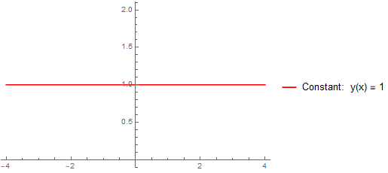
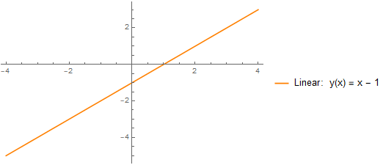
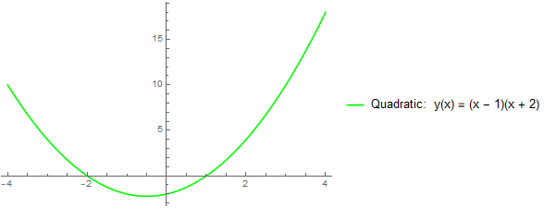
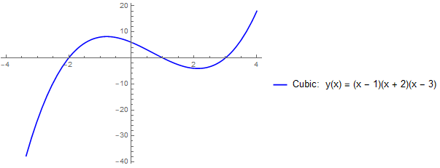
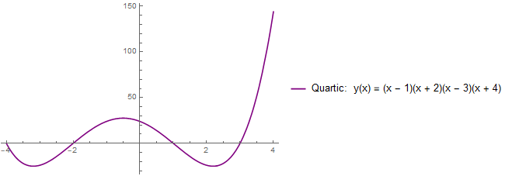
Extra Terms
Quadradic
Cubic
Quartic
Log Transformation
How each Model Function compares in each Regression/Classification technique
Leverage
Outlier
Autocorrelation

Slide 12
Last Topic
Something you had to do throughout the semester
Troubleshooting!

